Slide 1
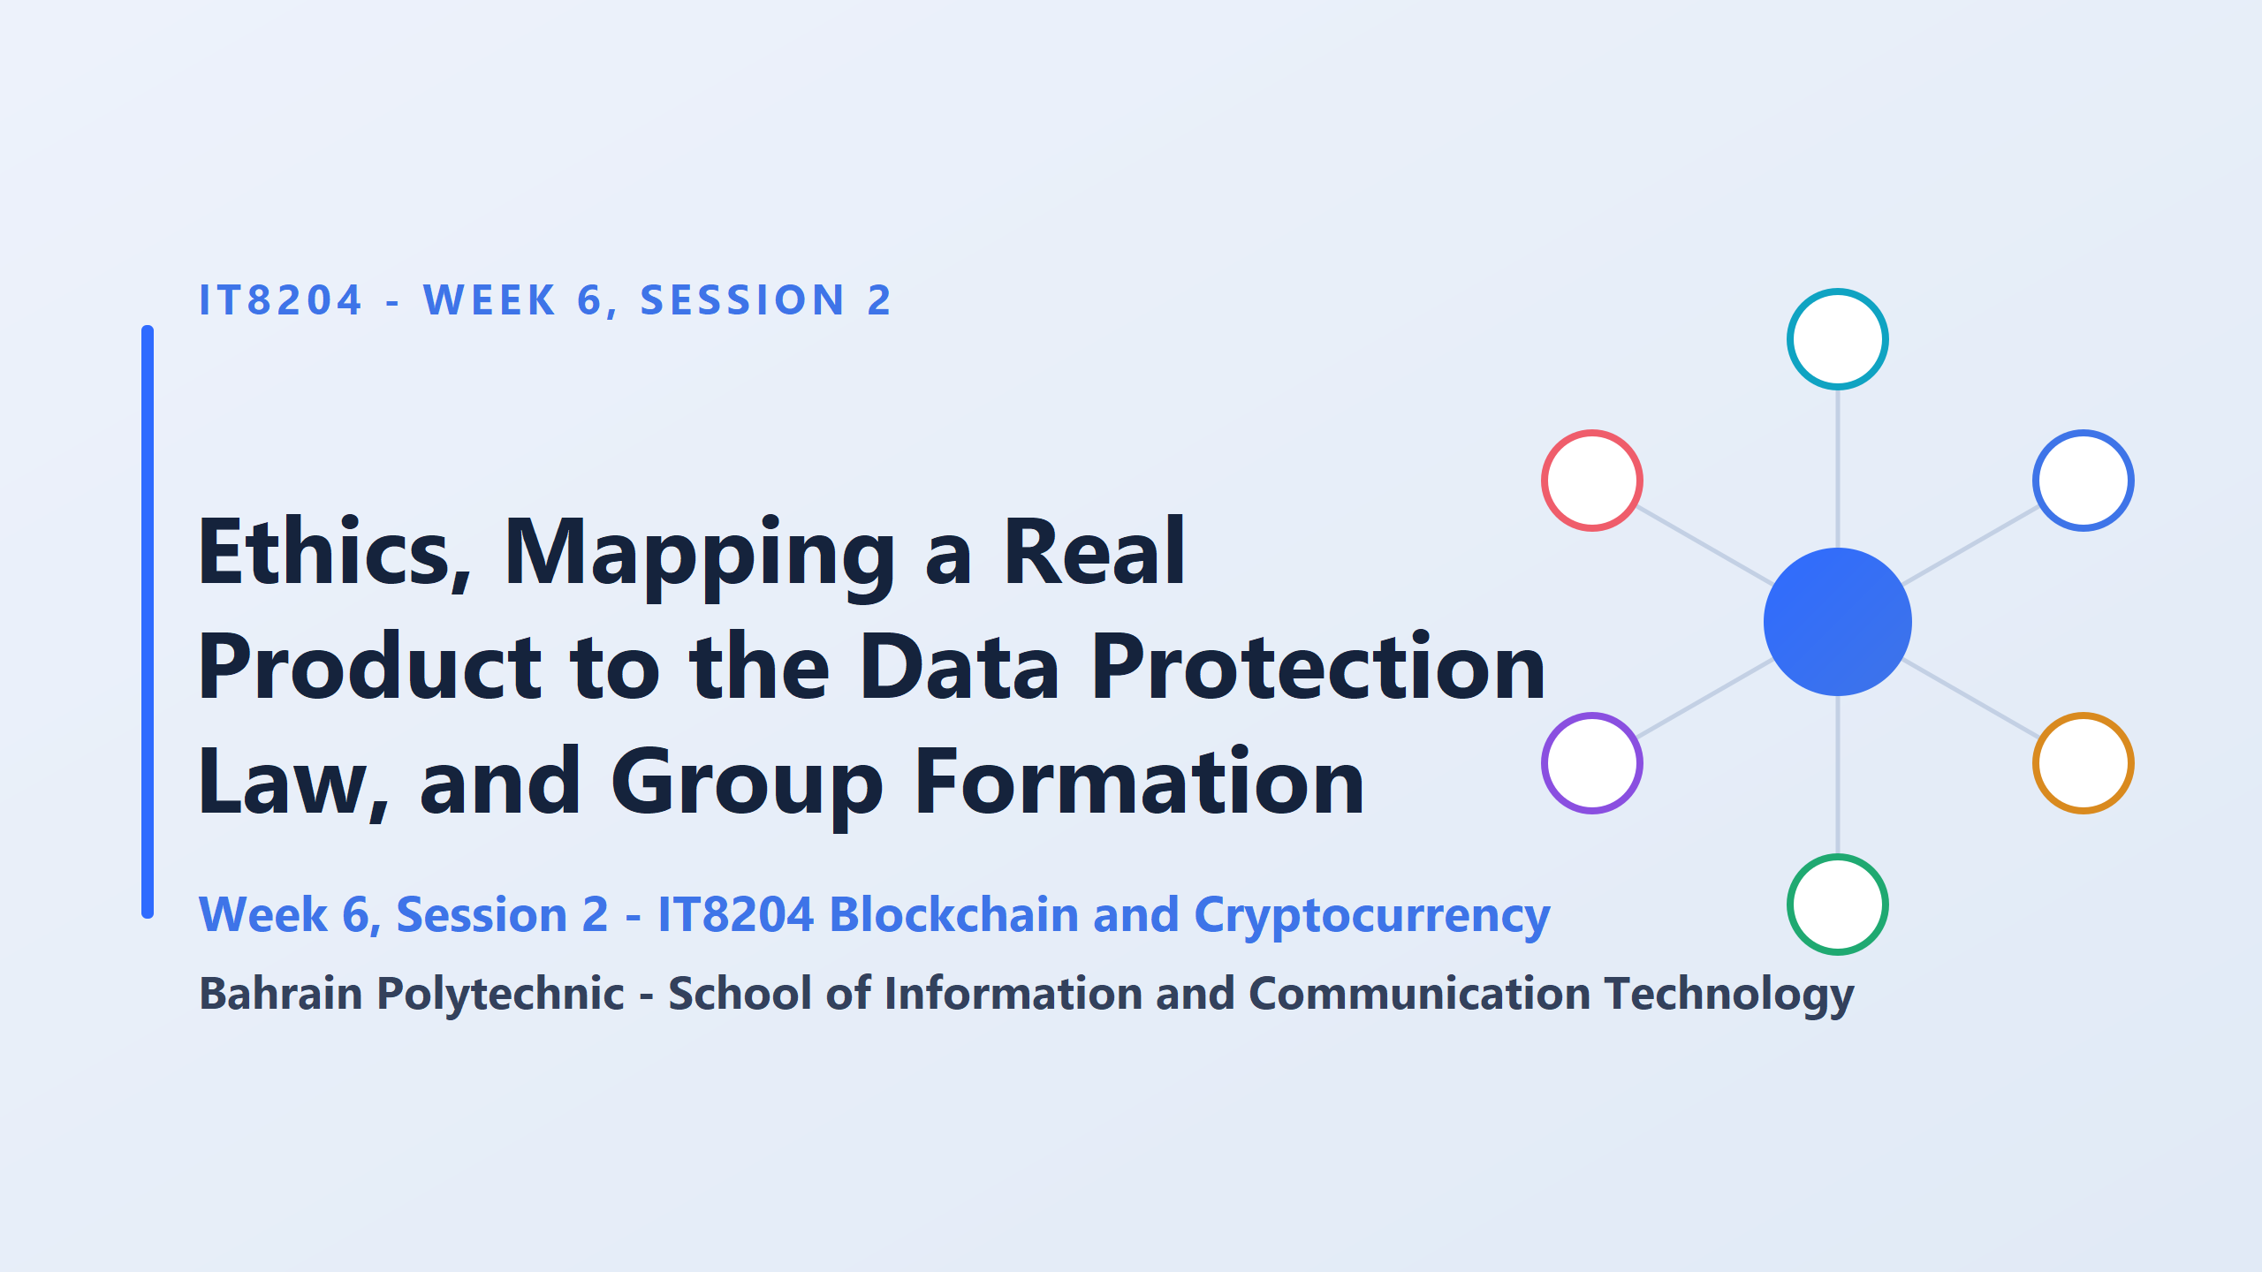
Who controls the data in a system with no central authority?
When nobody is in charge of a system, who is responsible for the people using it?

Slide 2
Suppose you download a mobile app that mishandles your private financial records or leaks your personal information.
Naturally, you’d demand accountability.
You’d complain to the company, report them to the data protection authority, or take legal action.
Now, imagine that same privacy leak happens on a decentralized app.
There is no company, no physical office, no customer support team, and no CEO.
The application runs entirely on automated code across thousands of nodes worldwide.
Who do you hold accountable? Who do you sue or report?

Slide 3
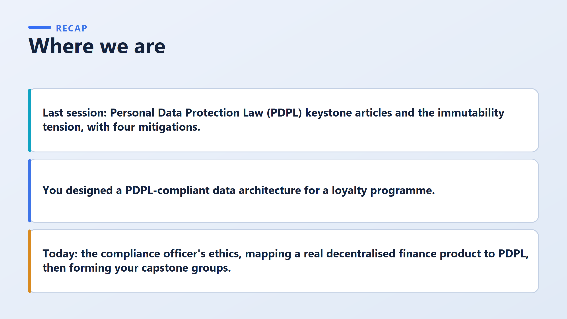
Today’s products have no bank behind them. This does not mean the law doesn’t apply. It means the law is hard to apply. Those are different things.
The duties still exist. The difficulty is finding who carries them.
Imagine your rights as a customer. Your data has rights, but nobody can be found who must respect them. Did the right disappear? No. The person responsible just hasn’t been found yet. Finding them is today’s work.
Common mistake to warn about:
“No company runs it, so no rules apply.” A good compliance professional never thinks this way, and it doesn’t protect the customer.
Remember:
No bank doesn’t mean no rules. Our job today is to find who carries the duties.
covered the key articles of the Personal Data Protection Law (PDPL) and one big problem, immutability (data that can’t be changed or deleted), along with four ways to reduce it
You put that knowledge into practice by designing a loyalty rewards system that followed data privacy laws
First, the ethics of a compliance officer. Second, taking a real decentralised finance (DeFi) product and mapping it to the PDPL. Third, forming your capstone groups.

Slide 4
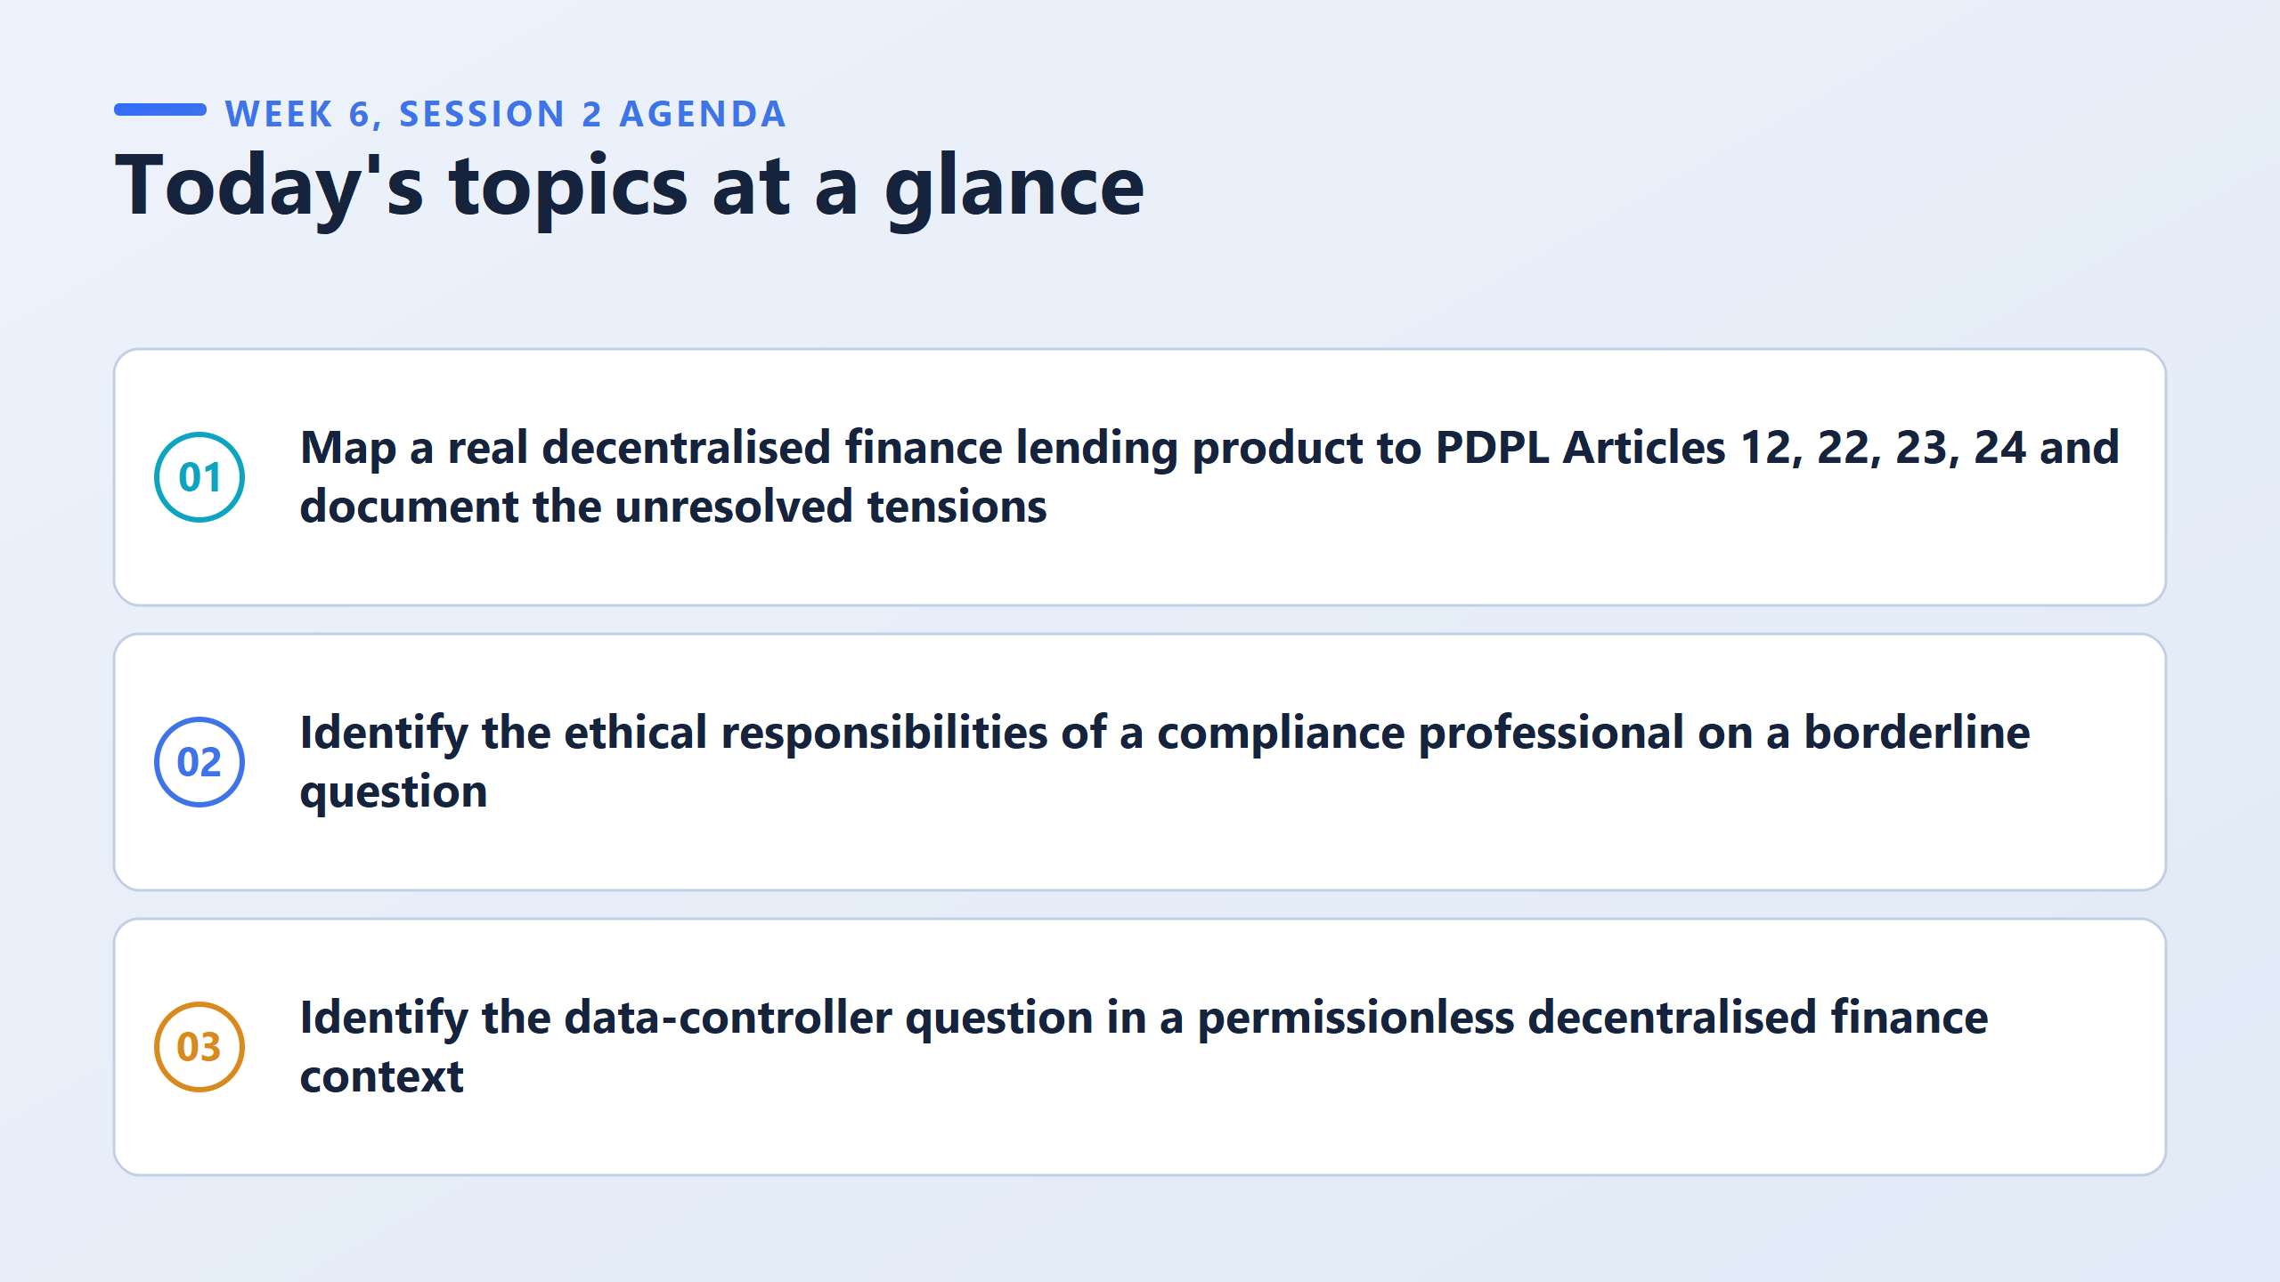
Take a real crypto lending app and match it against 4 articles of Bahrain's privacy law (PDPL).
The Catch: Because it's a real app (not a textbook story), some law conflicts will not have an easy fix.
Admitting that a problem cannot be fully solved is part of the right answer.
Judge what a compliance officer should do when a tech system sits in a legal grey area
Try to figure out who is legally in charge ("data controller") when using a decentralized app with no company behind it.

Slide 5
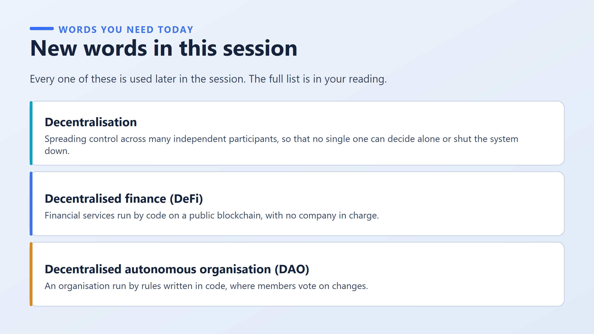
Means control is spread across many independent participants.
No single one can decide alone or shut the system down. It comes in degrees. It is not an on/off switch
Almost nothing is fully decentralised. So always think: how much, and who holds the rest of the control?
The simple three-question test:
Who decided?
Who benefits?
Who could switch it off?
If any answer has a name attached, the system is less decentralised than it claims.
Test: A chain with four validators, all in one country. Is it decentralised?
A validator is a computer chosen to propose or approve the next block.
Apply the test: control sits with only four participants in one country, so it is decentralised only to a small degree.

Slide 6
Decentralised does not mean nobody is responsible.
It means responsibility is harder to find.
Money services (like borrowing or lending) run entirely by automated software code on a public blockchain, without a central bank or company in charge
An online organization run by smart contract rules, where members hold tokens to vote on decisions

Slide 7
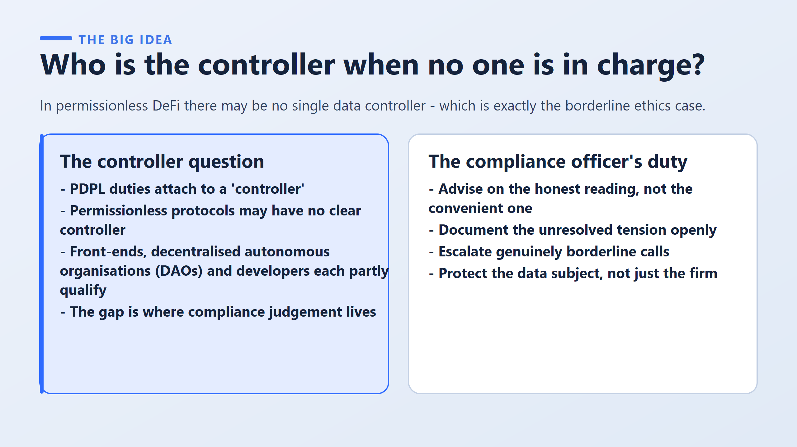
What is the problem?
What should a compliance officer do about it?
Think of it as “Who is responsible for the data?”
The law (PDPL) puts duties on one person or organisation: the controller, whoever decides why and how data is used.
Normally that is easy. A bank is the controller.
In DeFi, nobody is clearly in charge, so we can’t easily say who must follow the law.
There are three possible candidates (the website, the DAO, the developers), but each one is only partly responsible.
This gap is the problem.
Gap = the law is unclear here.
Think of it as “How should a good compliance officer behave when the law is unclear?”
1- Be honest. Give the true answer, not the answer the company wants to hear.
2- Write it down. Record the unclear part. Don’t hide it.
3- Pass it up. If it’s a really difficult decision, give it to someone senior who can accept the risk.
4- Think of the customer. Protect the person whose data it is, not only the company.

Slide 8
The controller question
Controller = whoever decides why and how personal data is collected and used.
It is about function, not job title. Don’t ask “who owns it?” or “who wrote the code?” Ask “who makes the decisions?”
Permissionless = open to anyone. Anyone can use it or build on it. There is no gatekeeper.
Put them together: The duties fall on whoever decides. The system was designed so no single party decides. So the test returns no answer.
Three partial candidates. Each has a claim, but none has the full claim:
Front-end: the website or app people use. Whoever runs it decides what data is collected there.
DAO: a group that governs a protocol by token-holder voting. It makes some decisions together.
Developers: they wrote the rules everything else follows.
The gap between these is where professional judgement is needed.
The compliance officer’s duty
When the law doesn’t settle a question, you don’t stop working. Four duties:
Give the honest reading, not the convenient one.
Write down the unresolved tension. Don’t leave it out.
Escalate genuinely borderline calls. Pass the decision to someone with the authority to accept the risk.
Keep the data subject in view, not only the firm.

Slide 9
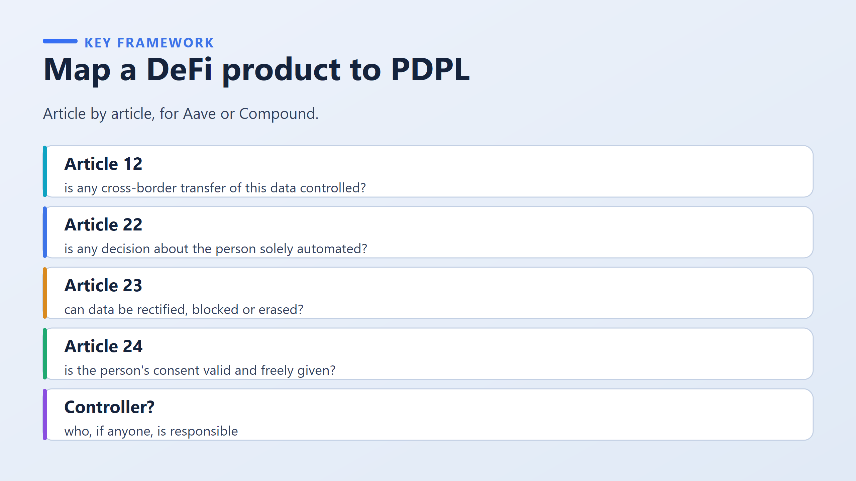
The aim: five questions they can ask about any product, and a rule for answering them honestly
Question | Plain meaning | DeFi difficulty
Article 12 | Does personal data leave Bahrain, and is that controlled? | The blockchain is copied to computers in many countries at once. There is no single “transfer” anyone can point to.
Article 22 | Is any decision about the person made only by a machine? | Smart contracts decide automatically (for example, liquidating a loan).
Article 23 | Can data be corrected, blocked or erased if the person asks? | The blockchain can’t delete (immutability).
Article 24 | Was the person’s consent real, freely given and for a specific purpose? | Using a protocol may not involve any real consent step.
Controller? | Who, if anyone, is responsible? | The gap from the last slide.

Slide 10
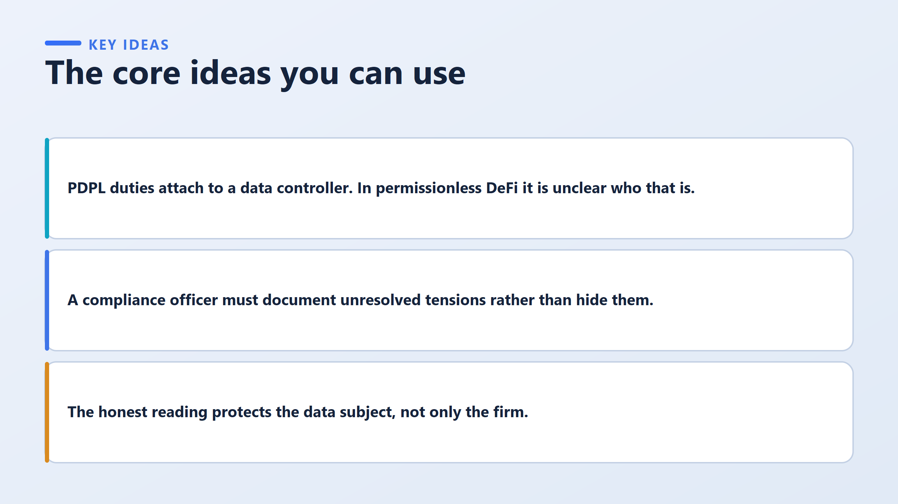
The first question in any data protection analysis is about people, not technology: who decides?
If you can’t name who decides, you can’t say:
who answers an erasure request
who answers the regulator
who is liable when things go wrong
In permissionless DeFi, the naming step fails, so everything after it becomes uncertain.
Why? Because of consequences.
A risk that is not written down was never chosen by anyone senior.
When it happens, the firm can’t show it made any decision.
The officer who knew is left holding it.
Writing it down moves the decision to the people whose job it is to decide. This is not paperwork to protect yourself. It is how accountability moves.
When the law runs out, write down what you know, send it to the right person, and protect the customer

Slide 11
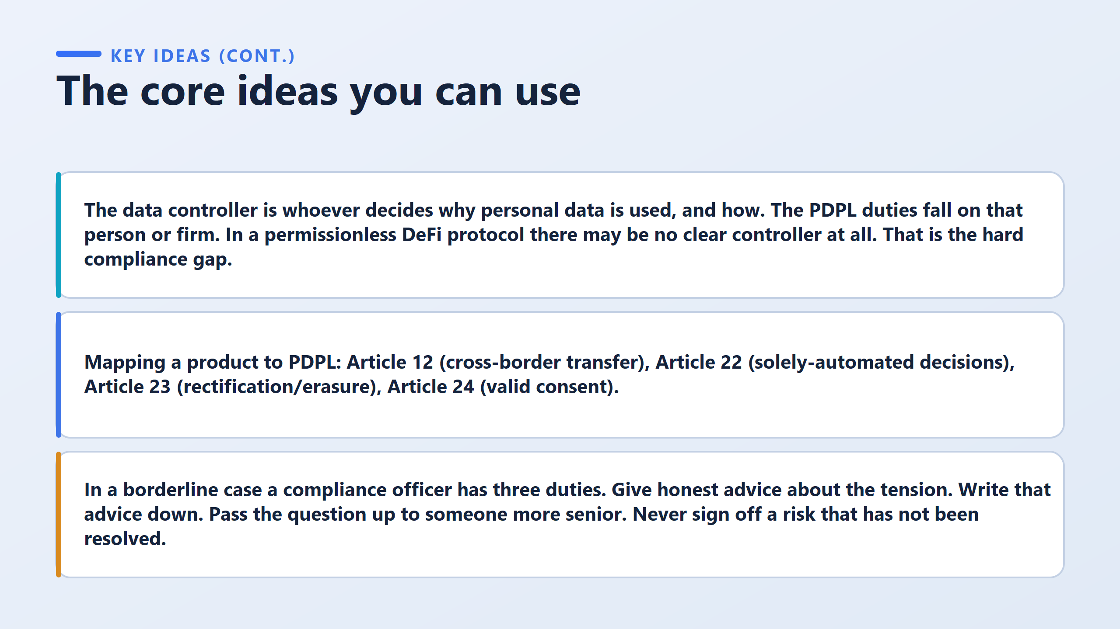
Example
A building inspector finds a crack in a wall and is not sure it is safe.
Honest advice: “I’m not sure this is safe.”
Writes it down in a report.
Passes it to the senior engineer.
Never stamps “approved” while the question is still open. If they stamp it, everyone assumes the building is fine.
Article | Topic | Simple meaning
12 | Cross-border transfer | Does data leave Bahrain?
22 | Solely-automated decisions | Is a decision made only by a machine?
23 | Rectification / erasure | Can data be corrected or deleted?
24 | Valid consent | Was consent real and freely given?
These four are now the standing checklist for any product in this course.
Notes:
How to explain it in class (about 1 minute)
“Three things to remember. First, the controller is whoever decides why and how personal data is used. In DeFi, we may not find one, and that is the hard gap. When you write about it, don’t force one answer. Split the product into parts and say which part has a controller and which doesn’t. Second, our standing checklist is four articles: 12, 22, 23 and 24. Third, if a case is borderline, advise honestly, write it down, and pass it up. And never sign off on a risk that is still unresolved, because your signature closes the question for everyone else.”
One sentence to remember
Find who decides, split the product into parts, be honest about the gap, and never sign off on an open risk.
The controller test is a test about decision-making. Applying it to a permissionless protocol is where the course's hardest gap appears.
The definition comes first, and the worksheet will use it. The data controller is whoever decides why and how personal data is processed, and the duties in the law fall on them. The definition has two halves. The why is the purpose. The how is the method. A party who decides only one of these is not automatically the controller.
Now we can apply the test to a permissionless protocol. There may be no clear controller. This is described as the hard compliance gap, not as a puzzle with an answer at the back of the book. That affects how you write. Suppose an answer says the controller is unclear. It explains which candidates partly qualify, and why none fully does. That is a strong answer. Suppose another answer picks one candidate and asserts it confidently, with no mention of the difficulty. That answer is weaker, even if the choice is defensible.
The phrasing is the hard part, so here is a strong example. The front-end operator decides what data is collected at the point of use, and so has a strong claim to being a controller for that data. Nobody appears to decide the purpose of the underlying protocol, so that part is unresolved. This is strong because it splits the product into parts and answers each part separately. It does not force one verdict onto the whole thing.
The four articles are the mapping set. Article 12 covers cross-border transfer. Article 22 covers decisions made solely by a machine. Article 23 covers rectification and erasure. Article 24 covers valid consent. These four are now the standing checklist for any product in this course.
In a borderline case, the duty is three actions in order: advise honestly on the tension, document it, and escalate it. One flat rule comes with them: never sign off on an unresolved risk. To sign off means to put your name to a statement that something is compliant. Once your name is on it, the question is closed as far as everyone else is concerned. That is why the rule is absolute.
Next, we run a real product through all of this.

Slide 12
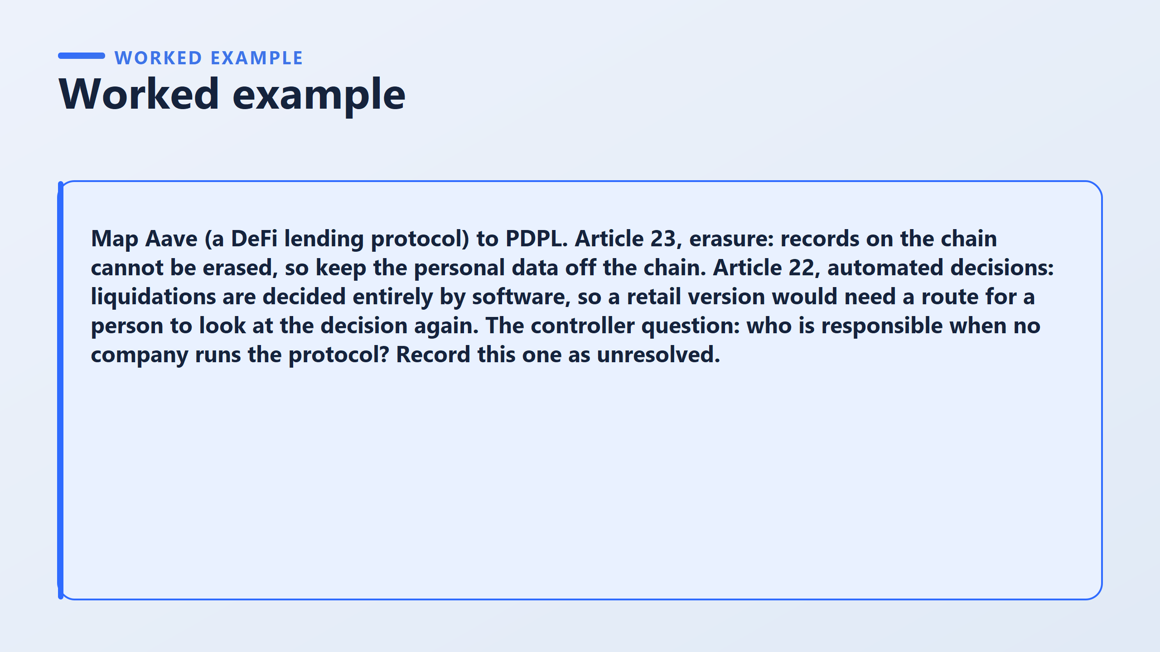
Article | Result | Type
23 (erasure) | On-chain records can’t be erased, so keep personal data off the chain | Clean. Same design rule as last session
22 (automated decisions) | Liquidations are decided only by software, so a retail version needs a human review route | Hard. Needs a design answer
12 (cross-border) | The record is copied worldwide by design, so there is no single transfer to control | Unclear
24 (consent) | No sign-up screen, nobody is asked anything, so consent is hard to show | Unclear / weak
Controller? | No company runs it, so who carries the duties? | Unresolved. Document and escalate

Slide 13
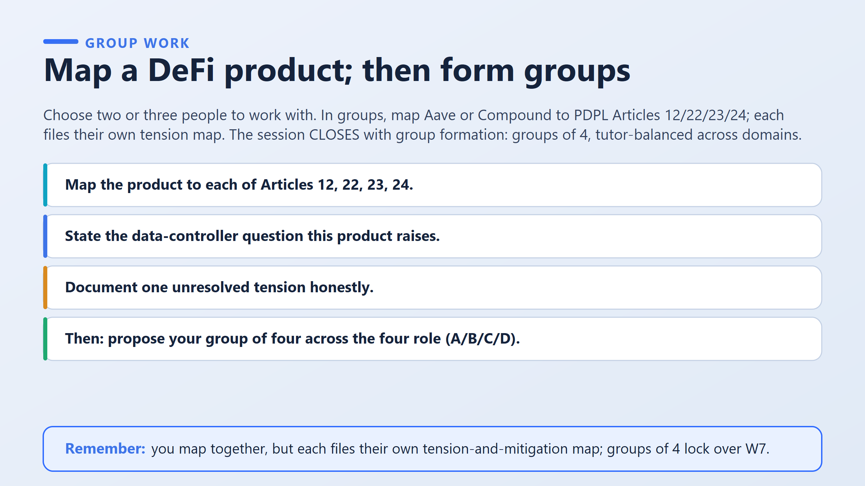
Step 1. Pick a team. Work with 2 or 3 classmates.
Step 2. Choose one product: Aave or Compound (both are DeFi lending products).
Step 3. Answer 5 questions together:
Article 12: Does personal data leave Bahrain?
Article 22: Does a machine make decisions about a person, with no human?
Article 23: Can data be corrected or deleted?
Article 24: Was consent real?
Controller: Who is responsible?
For each one, write Yes, No, or Unclear. Never leave a blank.
Step 4. Write your own tension map.
Even though you discussed together, each student writes and submits their own. It must include:
An answer for every article
“Unclear” stated honestly where it is unclear
The controller question, with the possible candidates weighed
One unresolved problem, plus what you would do: write it down and pass it to a senior person
Part 2: Form groups
Step 1. Choose 3 classmates you have worked well with (group of 4).
Step 2. Say which role each person prefers:
  A: Solution architecture
  B: Regulatory map
  C: Market viability
  D: Risk register

Slide 14
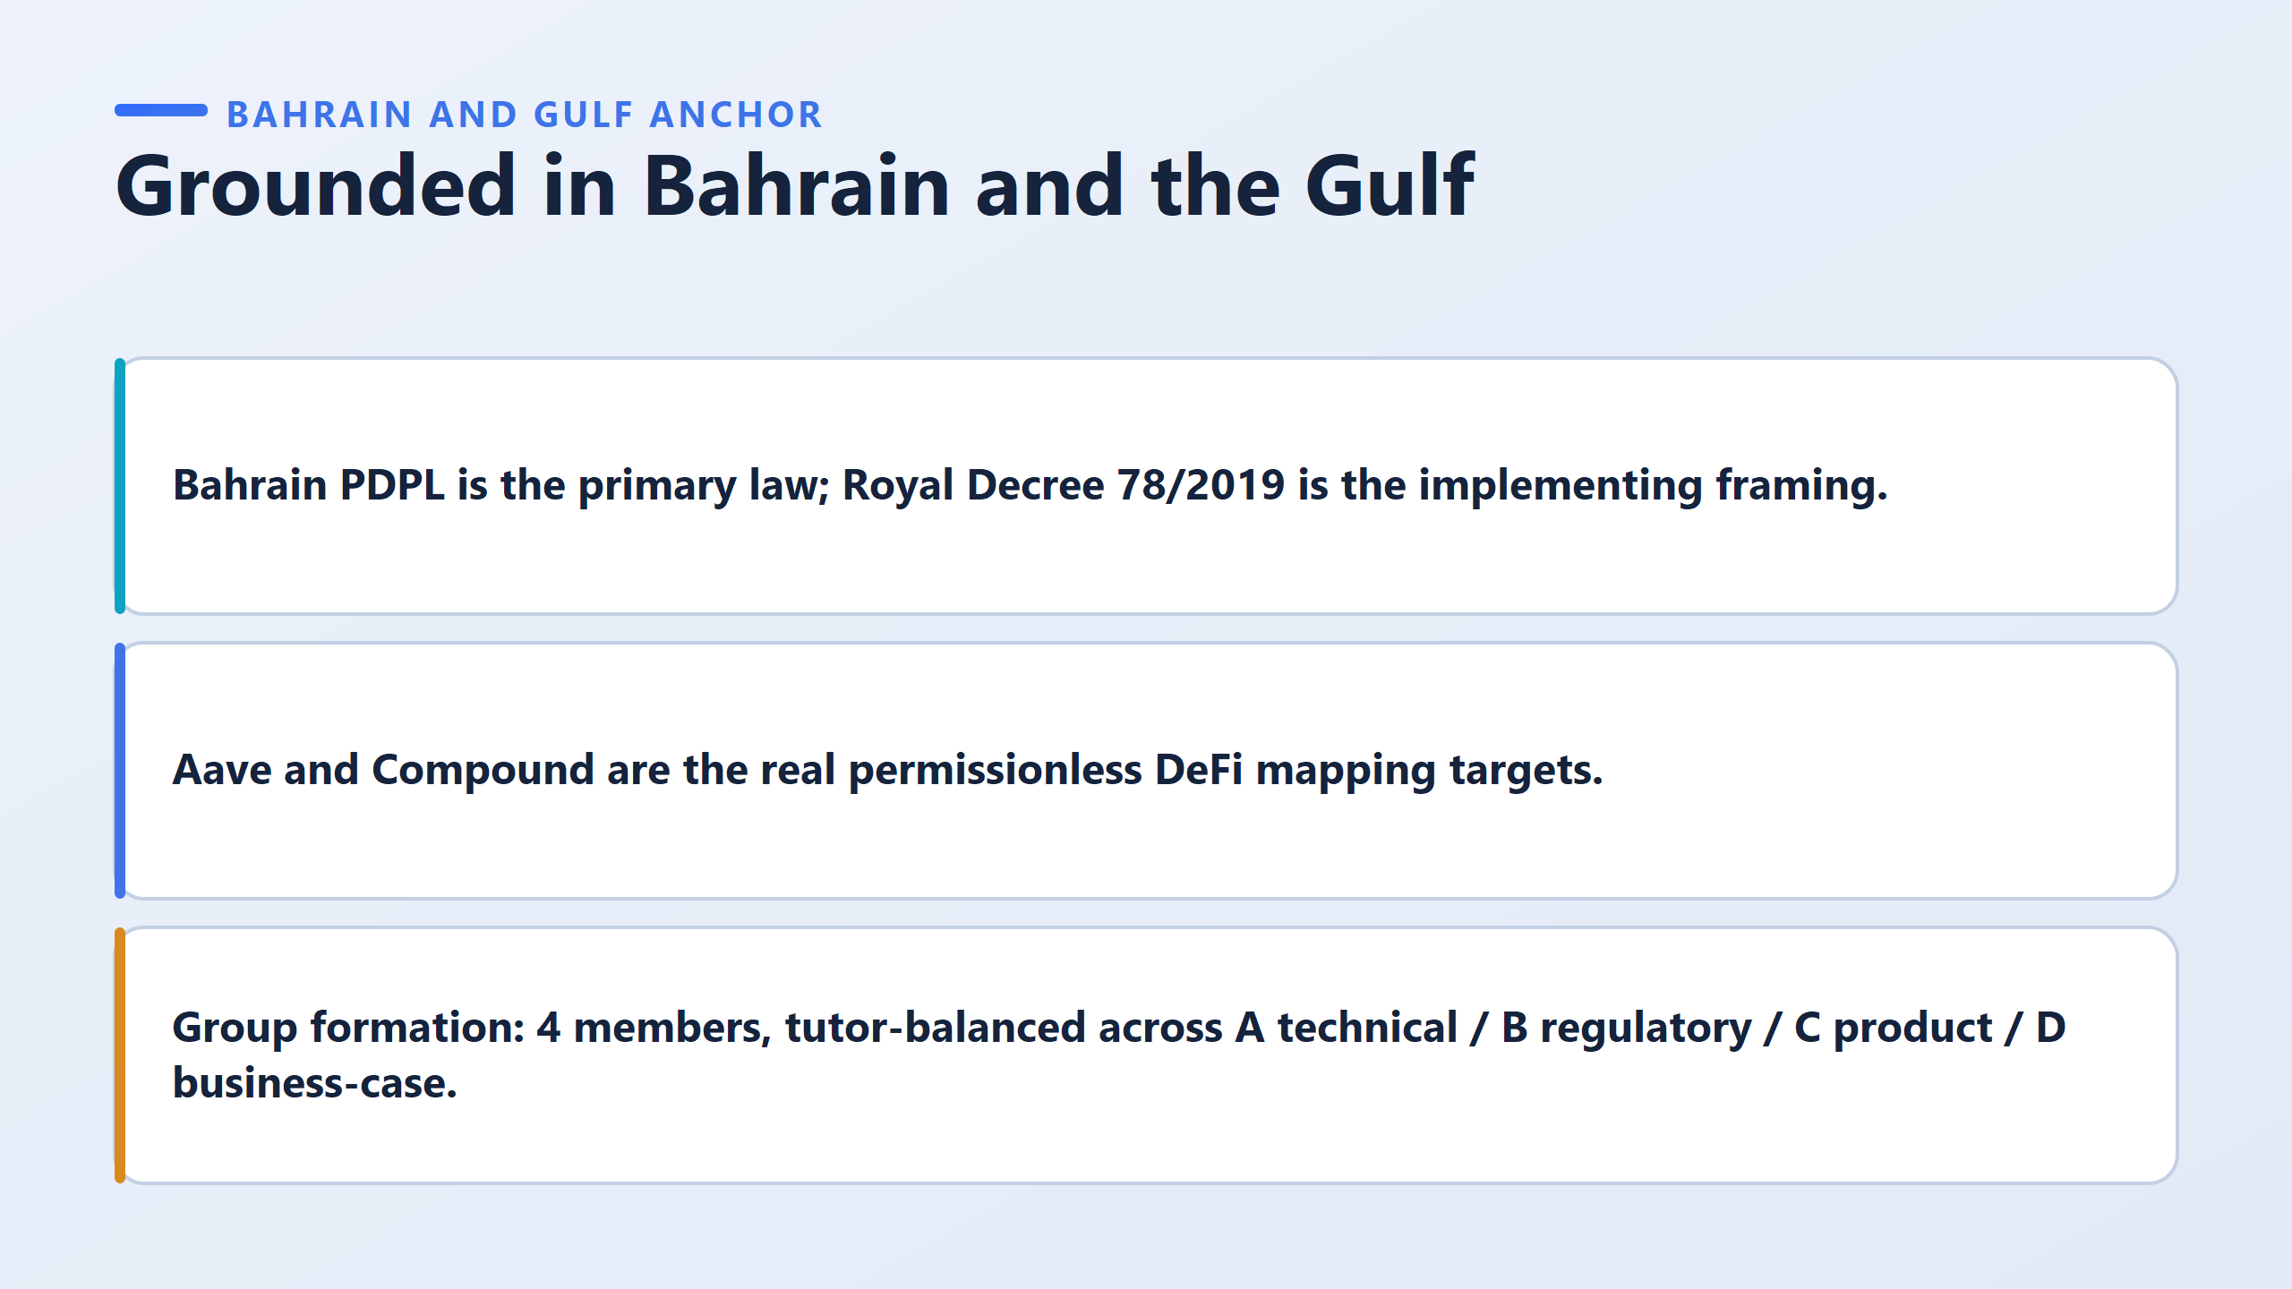

Slide 15
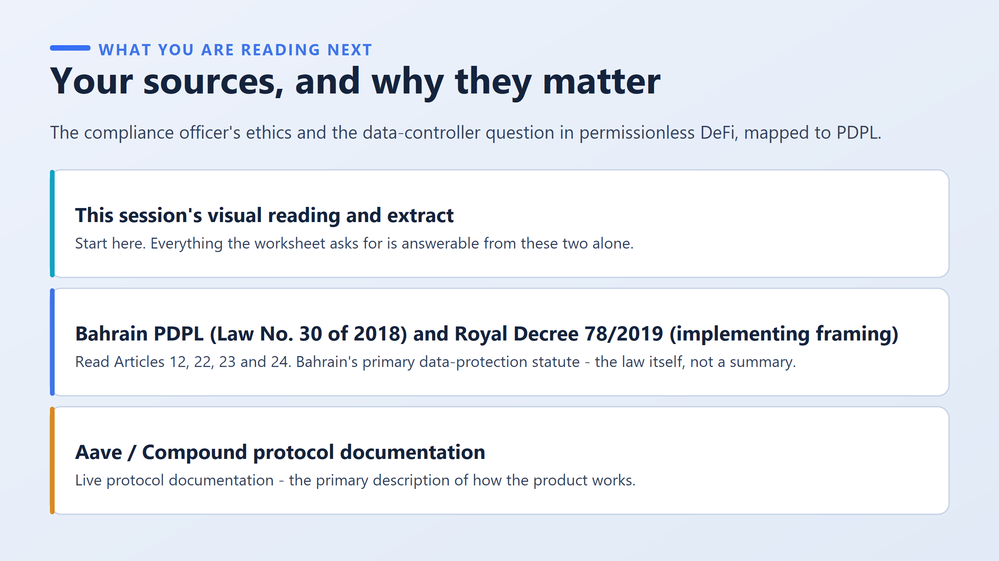

Slide 16
